Slide 1

Department of Artificial Intelligence and Data Sciences
AI-Driven Document Intelligence: A Comprehensive Approach to Classification, Q&A Handling, and Fraud Detection
Submitted By: Group 1
Shambhavi Rai 00901172020
Sonanshi Goel 01601172020
Princy Singhal 05101172020
Mehak Aggarwal 03401172020
Kanika Kanojia 06301172020
Supervisor :
Ms. Ritika Kumari
Assistant professor
AI & DS Dept.
Notes:
Good afternoon, esteemed colleagues and guests. Today, I am excited to share advancements from our latest project, 'AI-Driven Document Intelligence: A Comprehensive Approach to Classification, Q&A Handling, and Fraud Detection'

Slide 2
INDEX
Introduction
Literature Review
Research Gaps
Research Objectives
Proposed Methodology
Experimental Results
Conclusion and Future Scope
References

Slide 3
INTRODUCTION
With the growth in dependency on electronic verification systems used by both government and private organizations, there has been an increase in the usage of digitized manuscripts. This demands user-friendly and efficient document interaction tools.
Optimization of the document management process has become AI-driven with features like identity document classification, authenticity checking algorithms, and interactive question answering.
If we effectively identify the document type, we can streamline workflows and enable secure verification processes. The project employs Deep Learning techniques to classify documents like PAN cards, Aadhar cards, etc.
Additionally, we employ a Similar Document Template Matching Algorithm which can seamlessly extract features, match the template with a real document, and thereby detect fraud.
Furthermore, Large Language Models (LLMs) have been leveraged to enable interactive question answering over documents. Alongside these primary features, we have integrated additional functionalities such as paraphrasing, grammar checking, read aloud, and summarization. These enhancements aim to improve user interaction, making the system more versatile and accessible.
Experimental findings in our study showed the effectiveness of our work in improving efficiency, accuracy, and usability in document management.
Notes:
As we navigate through the digital transformation,there is a shift from paper to digital documents. This shift demands for 2 things- efficiency and accessibility.
So this transition comes up with challenges. Both governmental and private organisation face significant hurdles in managing and verifying the authenticity of these digital documents.
The Issues we have tackled are document fraud, inefficient retrieval systems, poor interaction capabilities.
These could hinder operational efficiency of both an organisation and an individual user.

Slide 4
LITERATURE REVIEW
REF NO | METHODOLOGY ADOPTED | RESEARCH GAPS | YEAR
01 | CNN, VGG-16 and YOLO | Long training time and image-containing documents require feature extraction. Deep learning uses the image directly for classification but is time-consuming and requires hyperparameter tuning. | 2021
02 | OCR and Similarity Score | Only looks at only one saved sample to predict the outputs, can be made to predict based on all saved samples of the speciﬁc template to generalize better and improve overall accuracy | 2019
03 | OCR and SSIM | Concerns persist due to variations in document layouts, necessitating comprehensive labeled datasets, scalability for large data, and adaptability to real-world scenarios. | 2023
Notes:
We evaluated existing solutions and found key issues. Traditional CNNs, despite their power, take too long to train and need lots of fine-tuning for image-heavy documents. YOLO, is fast, but misses small or complex objects.
For fraud detection with document template matching, earlier methods need a lot of labeled data and struggle with small differences between documents. They also rely too much on OCR rather than feature-based matching.
In AI-driven question answering, recent tools like UniGen and ToolQA face challenges. They are either too complex and resource-heavy or fail to connect information efficiently, making them slow and hard to scale.

Slide 5
REF NO | METHODOLOGY ADOPTED | RESEARCH GAP | YEAR
04 | Closed-book Generation (T5) and (BART) Retrieval-augmented Generation(RAG) LLM-based Generation models (gpt-3.5-turbo-0613) and (LLaMA2-13B-Chat) | The study lacks a comparative analysis of the integrated UniGen framework against separate models for Generative Document Retrieval (GDR) and Grounded Answer Generation (GAR), hindering understanding of its comparative advantages. | 2024
05 | Automated question generation with human-guided templates. | ToolQA heavily relies on external tools for question answering, which could introduce biases or limitations based on the effectiveness and coverage of these tools. | 2024
06 | Phishing sites blacklist generator | Generated blacklists for phishing sites, might need upda

Slide 6
RESEARCH GAPS
Integrated Technology Approach:
Existing Gap: Prior research often isolates document classification,OCR etc. Hence missing the synergy of combined technologies.
Our Contribution: Seamlessly integrates classification, NLP, and speech synthesis etc for a unified solution.
Robust Performance in Varied Conditions:
Existing Gap: Challenges in achieving consistent accuracy across different imaging conditions.
Our Contribution: Employs advanced data augmentation and fine-tuning to ensure reliable classification and fraud detection in diverse environments and document types.
Efficiency & Accuracy:
Existing Gap: Traditional CNN architectures, while powerful, are hampered by lengthy training times and intensive hyperparameter tuning when processing image-heavy documents.
Our Contribution: Achieves an optimal balance between high accuracy and computational efficiency, leveraging pre-trained models.
Integration Challenges in AI-Driven Q&A Systems:
Existing Gap: Recent tools are either too complex and resource-heavy or fail to connect information smoothly, making them inefficient for fast and large-scale applications.
Our Contribution: Implements a streamlined, efficient Q&A system that balances resource usage with effective information retrieval, ensuring scalability and speed.
Notes:
Our research bridges important gaps by combining document classification, NLP, OCR, and speech synthesis into one powerful solution. We improve accuracy across different conditions using advanced techniques, making our system reliable for various documents. By using pre-trained models, we achieve high accuracy without the long training times of traditional methods. Finally, our efficient Q&A system provides quick and scalable information retrieval, balancing speed and resource use.

Slide 7
RESEARCH OBJECTIVES
Optimizing Architectures:
Improve performance by modifying custom CNN architecture.
Evaluate the impact of pretrained models (e.g., VGG16, VGG19).
Dataset Formulation:
Utilize advanced data augmentation for robust classification model training.
Create test cases to detect subtle document fraud variations.
Real-Time Document Processing:
Develop efficient models for real-time classification, interactive query answering, and fraud detection.
Efficient Information Retrieval Systems:
Implement sophisticated question answering systems using NLP and semantic search for real-time information extraction from unstructured PDFs.
Quality Fraud Detection Mechanisms:
Create robust template matching algorithms with ORB feature descriptors to detect subtle identity document forgeries.
Enhancement of Document Accessibility and Quality:
Incorporate auxiliary features like text-to-speech, summarization, grammar checking, and paraphrasing to improve accessibility, comprehension, and quality.
Notes:
Our research improves CNN models with pretrained VGG16 and data augmentation for enhanced training and fraud detection.
We implement real-time classification, query answering, and fraud detection.
enhance document accessibility with text-to-speech, summarization, and grammar checking.

Slide 8
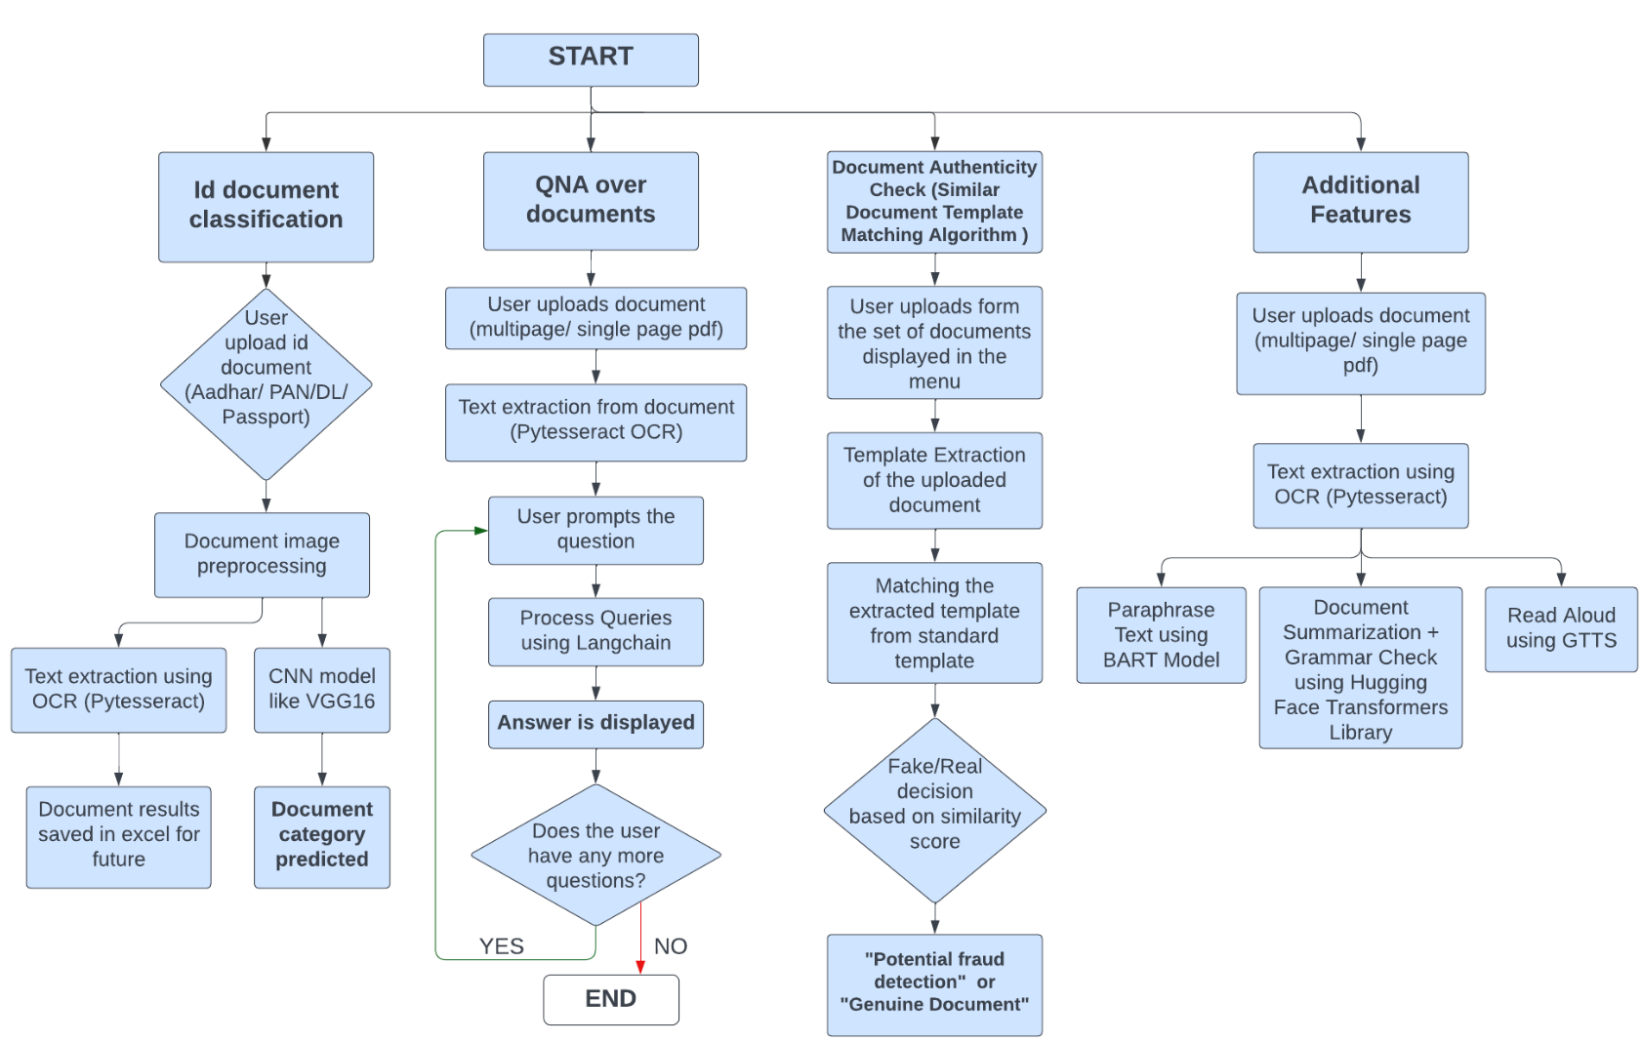
PROPOSED METHODOLOGY
Notes:
Our project streamlines document processing and verification using advanced AI techniques, as outlined in the flowchart:
1. ID Document Classification:
Users upload ID documents (e.g., Aadhar, PAN, DL, Passport), which are then preprocessed for clarity.
OCR (Pytesseract) extracts text from the documents, Document details which are extracted using OCR are saved in an Excel file for future use.
and a CNN model, such as VGG16, classifies the document category.
2. Q&A Over Documents:
Users upload documents (single or multi-page PDFs).
Then the OCR extracts text from the document.
Users can ask questions about the document content, with queries handled by Langchain and Answers are displayed.
Users can continue asking questions or end the session.
3. Document Authenticity Check:
Users upload a (single page) document from a set of predefined documents.
Now for the uploaded document, template is extracted.
The extracted template is compared with the standard template.
and the system decides if the document is fake or genuine based on similarity scores.
now, Result indicates if the document is "Potential fraud" or "Genuine Document."
4. Additional Features:
User Inputs a document (single or multi-page PDFs) and Text Extraction is done using OCR.
Paraphrasing: Text is paraphrased using the BART model. [Bidirectional and Auto-Regressive Transformer]
Summarization & Grammar Check: Documents are summarized and checked for grammar using Hugging Face Transformers.
Read Aloud: The document text is converted to audio using gTTS(google text to speech library)
This comprehensive approach ensures accurate document classification, real-time query answering, robust fraud detection, and enhanced document accessibility and quality through additional features.

Slide 9
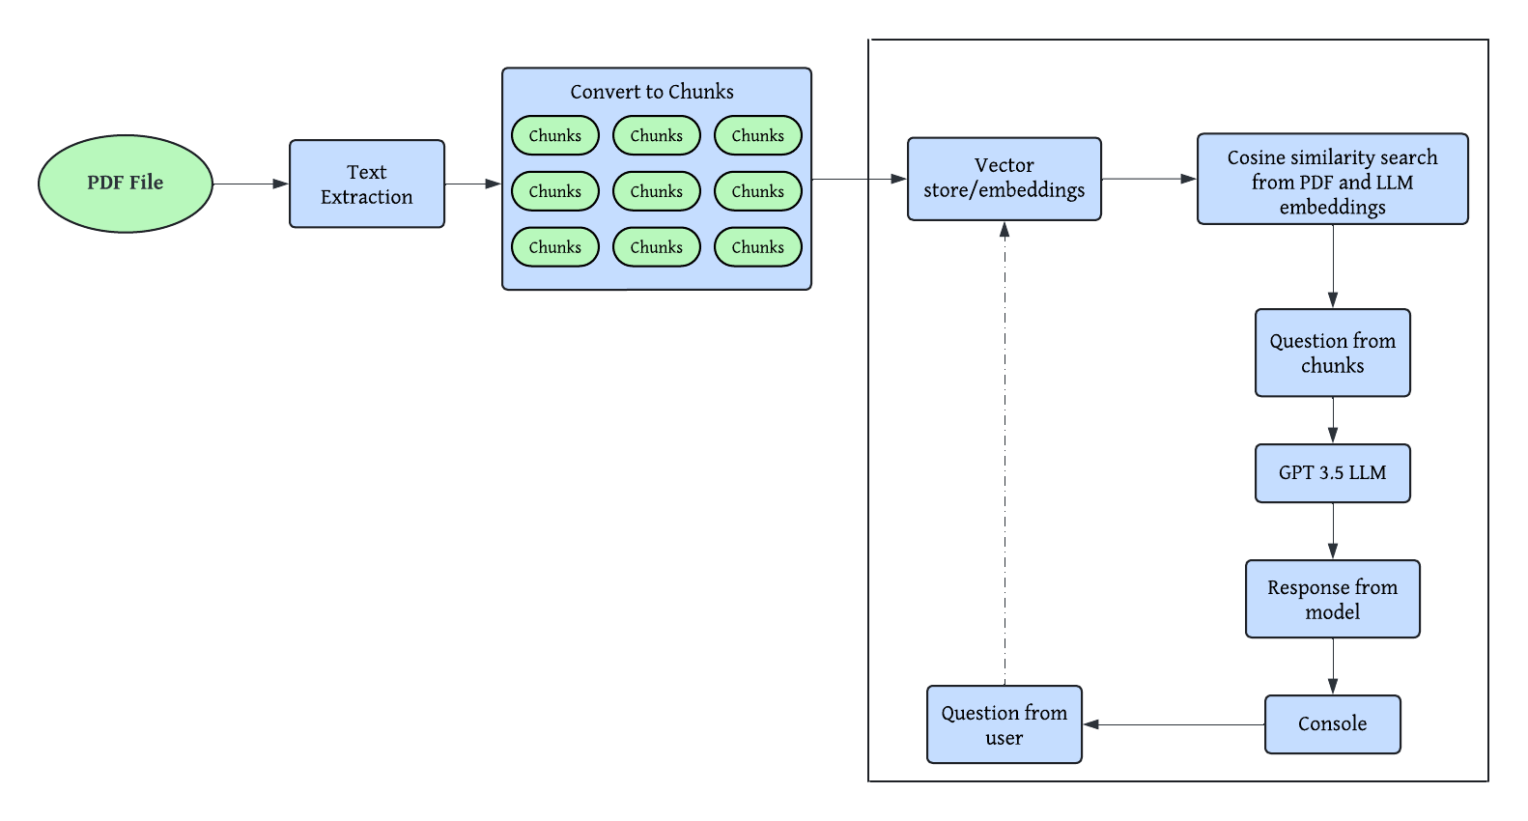
I) INTERACTIVE QUERY ANSWERING
Leverages advanced Language Learning Models (LLMs) combined with OpenAI embeddings to iteratively extract and provide accurate answers from documents. This approach ensures enhanced context understanding and precise information retrieval, improving the overall efficiency and reliability of the QnA process
(Using PyPDF2)
(Using OpenAIEmbeddings)
(Using CharacterTextSplitter)
System Architecture of Interactive Query Answering
Notes:
iterative Question and Answer (QnA) system that leverages advanced Language Learning Models (LLMs) and the Langchain framework to efficiently extract and process information from documents, delivering immediate and relevant answers to user queries. The process begins with users uploading a PDF document, from which text is comprehensively extracted and split into manageable chunks using a Character Text Splitter. Each chunk is converted into embeddings using OpenAI's models and indexed with FAISS for efficient similarity searches.
When a user inputs a question, the system uses Langchain to retrieve the most relevant text chunks, which are then processed by an LLM to generate accurate answers. The system's interactive nature allows users to ask follow-up questions iteratively until they have all the information they need.This approach ensures precise and contextually relevant responses, enhancing the overall user experience

Slide 10
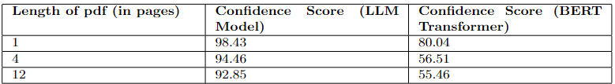
EXPERIMENTAL RESULTS
Comparison between LLM and BERT
Notes:
In the comparative analysis between LLM and BERT Transformer based on PDF length, confidence scores varied. BERT's scores decreased from 80.04 for a 1-page PDF to 55.46 for a 12-page one, indicating a challenge in maintaining confidence with longer documents. Conversely, LLM exhibited consistently high confidence, with scores ranging from 98.43 to 92.85 across the same PDF lengths. This suggests LLM's robustness in processing longer texts and maintaining confidence in generated answers. While BERT may struggle with prolonged contexts, LLM's generative capabilities enable it to comprehend and produce coherent responses even with extensive input

Slide 11
II) SIMILAR TEMPLATE MATCHING ALGORITHM
(Code)
ROI extraction
Preprocessing the extracted ROIs
Feature Extraction
Template Comparison
Classifying the input as Fake or Real
Identify crucial sections such as text blocks and image areas, that contain key information for analysis.
Enhance image quality by reducing noise and improving contrast to facilitate feature detection.
Detect unique & distinguishing features like edges, corners & contours from preprocessed ROIs
Compare extracted features with standard templates, accounting for minor variations.
Determine if the document is "Fake" or "Real" based on similarity scores and thresholds.
Template Extraction
Template Matching
Fraud Detection

Slide 12
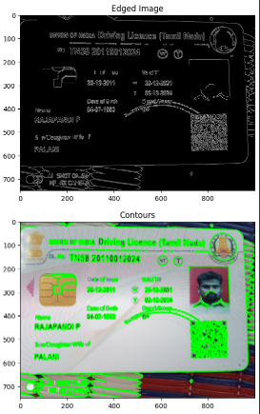
ROI extraction
Document IMAGE
Transform into grayscale
Using OpenCV
Edge Detection
Using dynamic thresholding
Contour Detection
for separating out specific areas
List of extracted ROIs
Output
Each ROI is passed for preprocessing
Edge and Contour detection

Slide 13
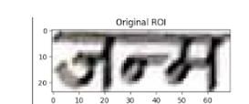
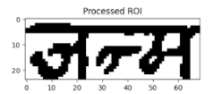
Preprocessing ROIs
Loop through each ROI
for (x, y, w, h) in rois:
Crop ROI from Document Image
roi_image = document_image[y:y+h, x:x+w]
preprocess_function(roi_image)
Noise Reduction
denoised = cv2.fastNlMeansDenoising(gray, None, 30, 7, 21)
Contrast Enhancement
CLAHE
Binary Thresholding
Otsu
Morphological Operations
Store Preprocessed ROIs
OUTPUT

Slide 14
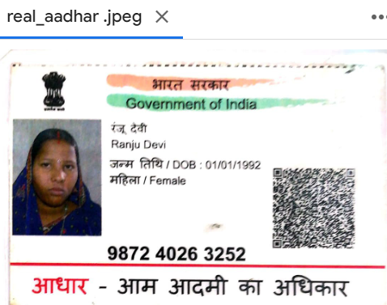
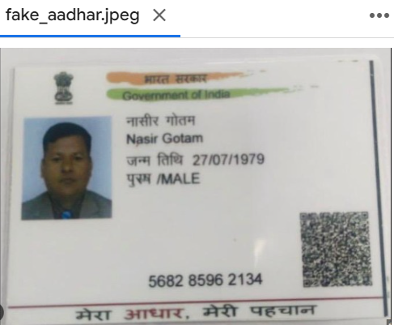
Feature Extraction, Template Matching & Fraud Detection
Pass preprocessed ROIs list to extract_features function
ORB (robust, rotation-invariant)
Genuine
Potentially fake
Detect Keypoints and Compute Descriptors
True
False
if (good_matches > match_threshold) or (similarity_score > similarity_threshold)
Match Features with standard Template
Classify Document Authenticity
similarity_threshold=0.47
Calculate Total matches
Brute-Force Matching with Hamming Distance
match_threshold=30
Calculate Good matches
K nearest neighbor
k=2, nearest neighbour ratio=0.75
Evaluate Matches
Calculate Similarity Score
Calculate SSIM Score
SSIM_THRESHOLD = 0.47
Good_matches/Total_matches

Slide 15
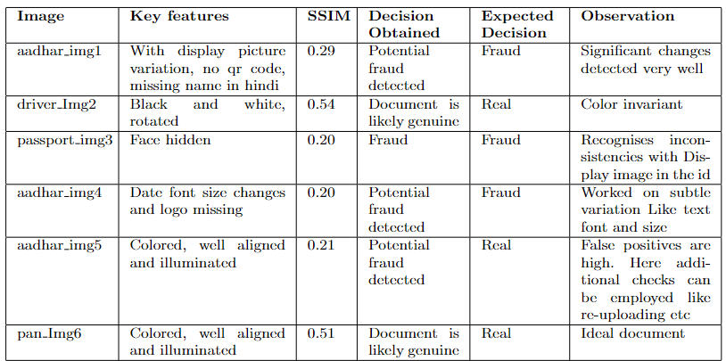
EXPERIMENTAL RESULTS
Analysis of Document Authenticity through Feature Matching and SSIM Evaluation

Slide 16
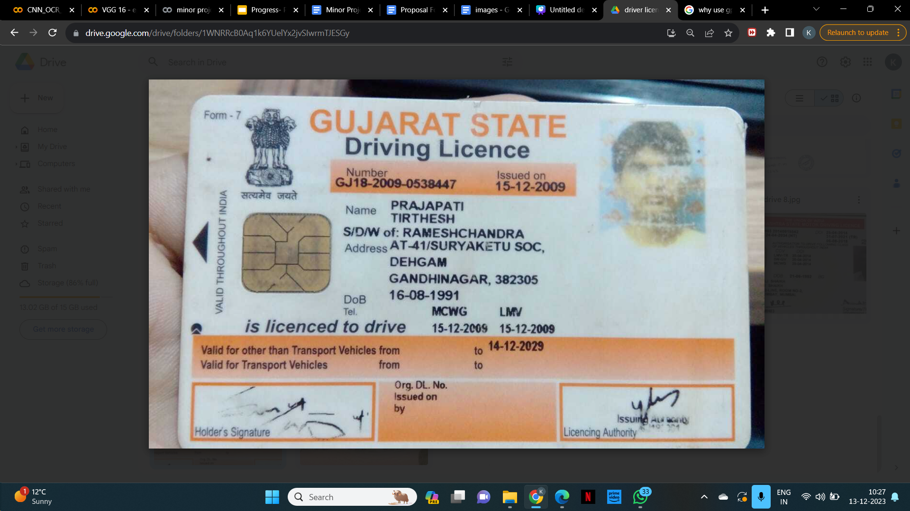
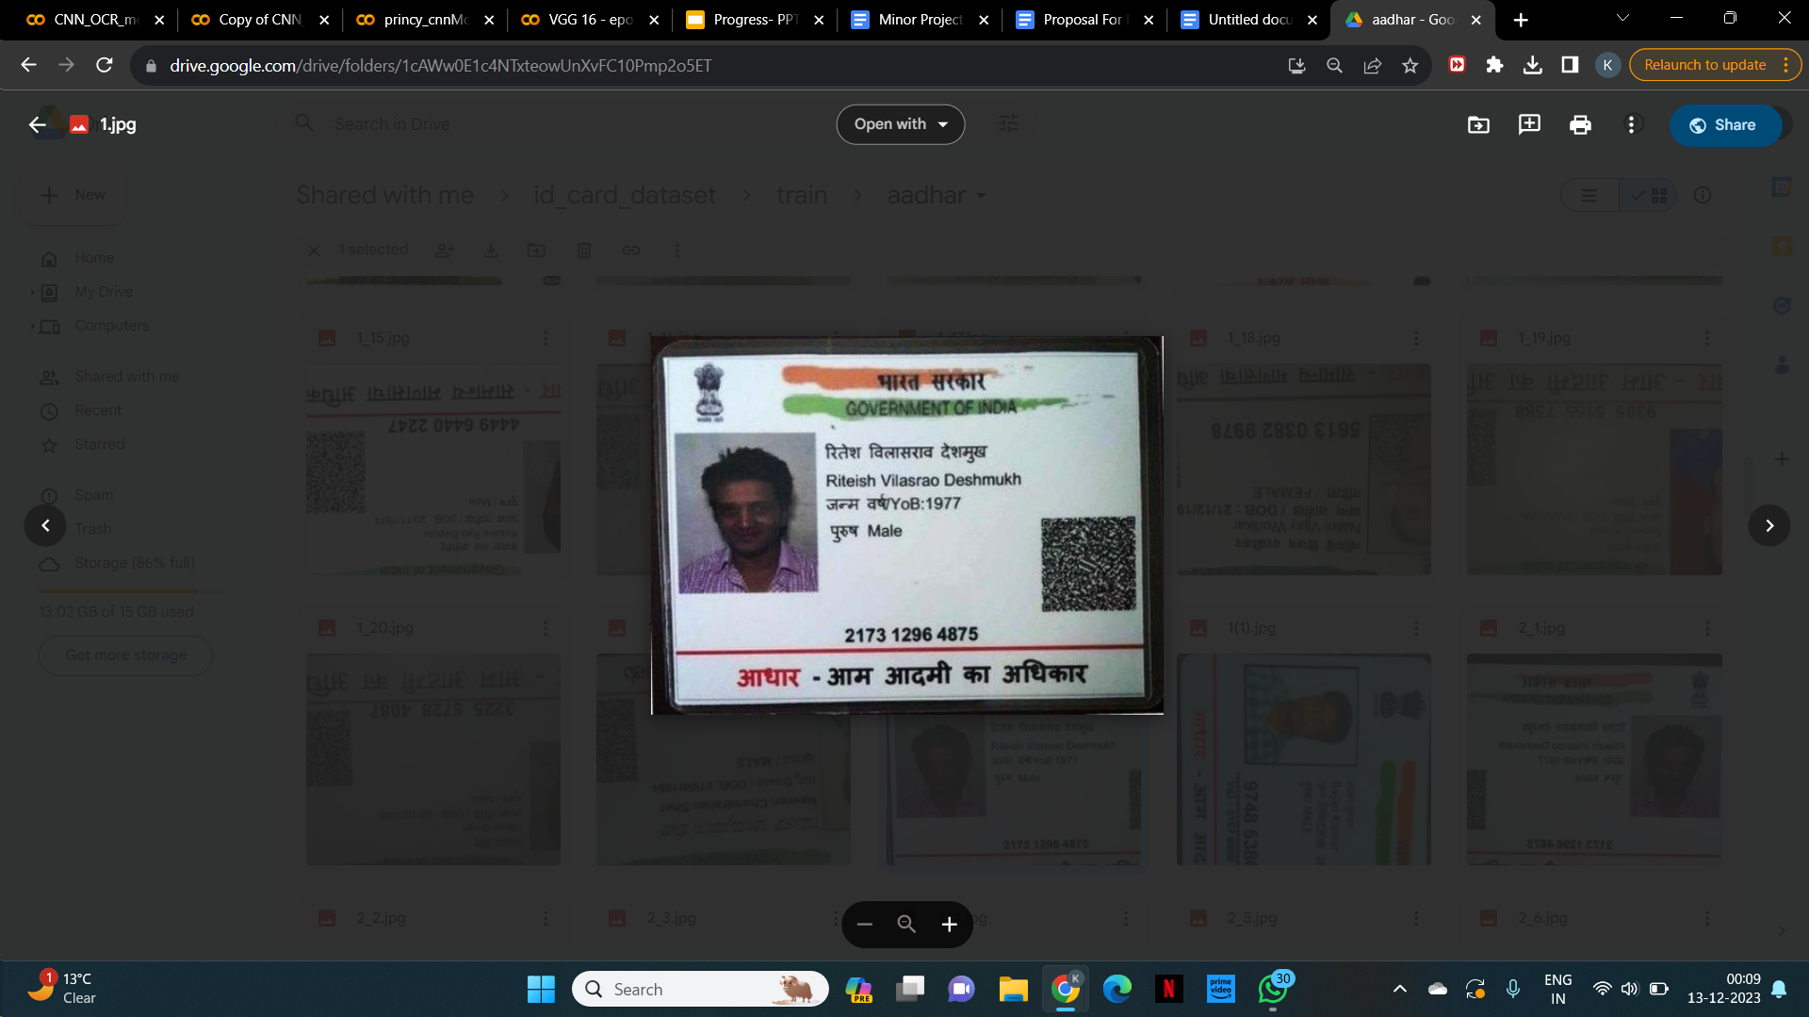
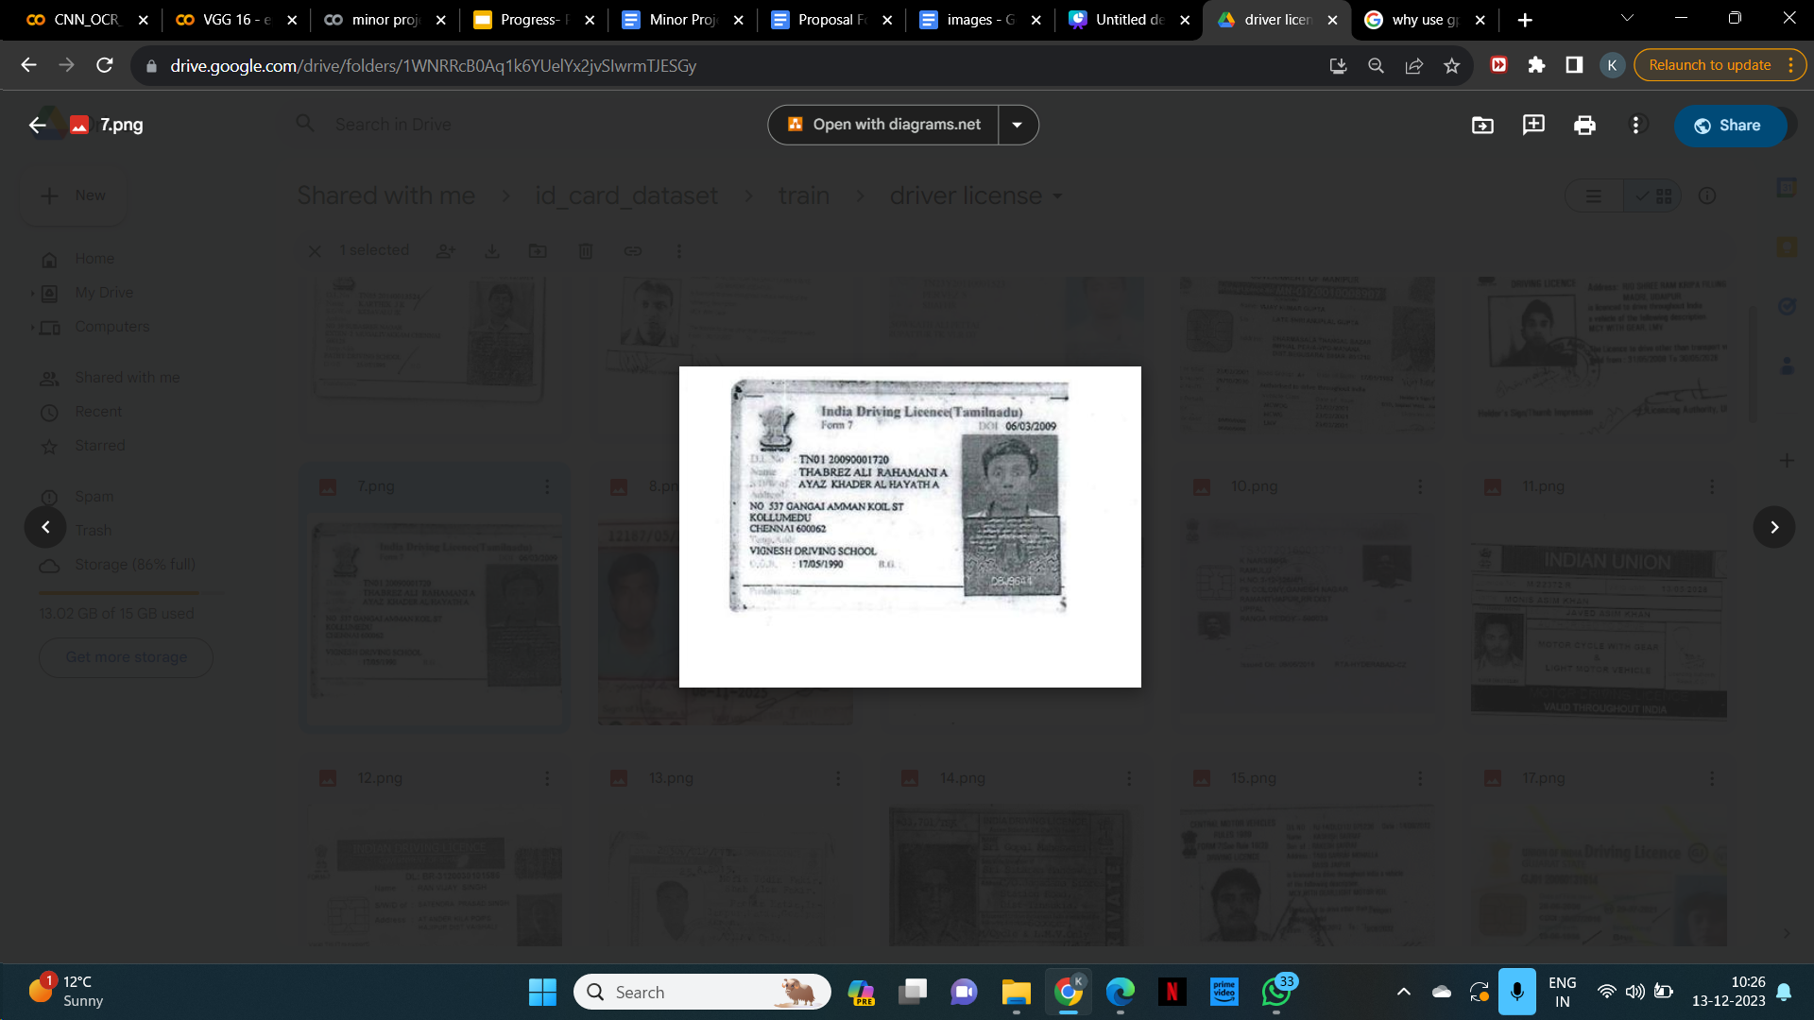
III) DOCUMENT CLASSIFICATION
Our model employs a custom CNN architecture particularly designed with convolutional layers progressively increasing in filter count, dropout layers to reduce overfitting, and dense layers to finalize classification. This specialized CNN architecture provides powerful feature extraction, allowing the model to recognize detailed patterns unique to each document format. In parallel, the use of the pre-trained VGG16 model improves feature extraction capabilities, resulting in a more detailed representation of document features.
Dataset Overview :
Few images from Training set
Notes:
Our Classification model uses a custom CNN architecture with layers that
increase in filter count, dropout layers to prevent overfitting, and dense layers for classification. It also integrates the pre-trained VGG16 model for enhanced feature extraction.
The images below are examples from the training set.

Slide 17
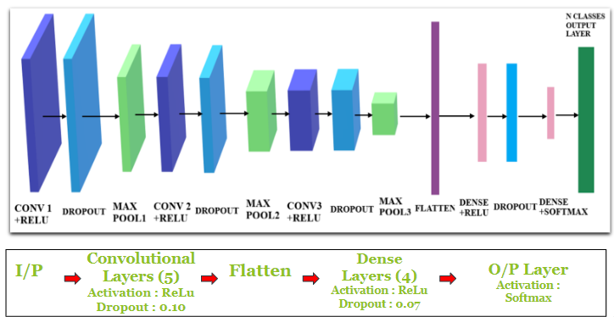
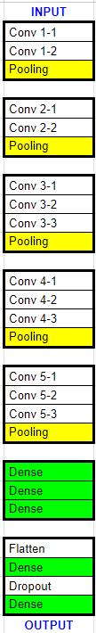
Proposed Classification Model
CNN Model Layers
VGG16 Model Layers
VGG16
Additional layers
Notes:
This slide represents the architecture of our classification model
The CNN Model Layers include
Input Layer (I/P)
5 Convolutional Layers : Activated by ReLU with a dropout rate of 0.10.
Flatten Layer
4 Dense Layers : Activated by ReLU with a dropout rate of 0.07.
Output Layer (O/P): Uses softmax activation for final classification.
The VGG16 model layers are shown, highlighting the convolutional and pooling operations in detail. After the VGG16 layers, additional layers are added to enhance the model's performance, including flattening and dense layers with dropout. Overall, this combination ensures effective feature extraction and classification, leveraging both the custom CNN and VGG16's powerful capabilities.

Slide 18
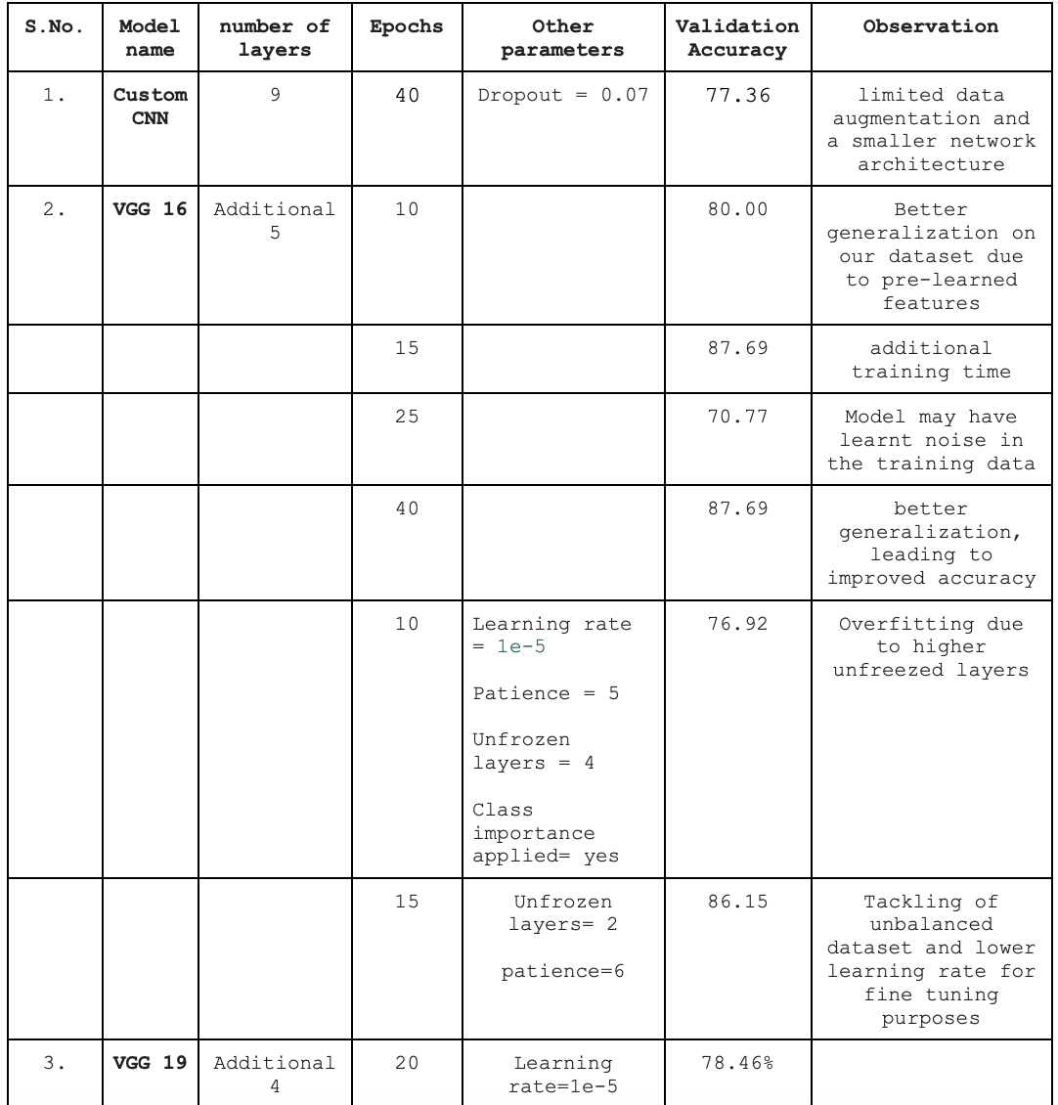
EXPERIMENTAL RESULTS
Custom CNN model results with hyperparameter tuning
link
Additional
4
link
Notes:
these are the results obtained in hyperparameter tuning of the models.
for VGG16 model, 87.69% validation accuracy was achieved with 15 epochs

Slide 19
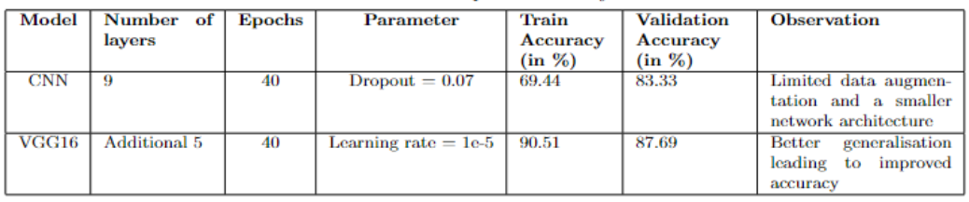
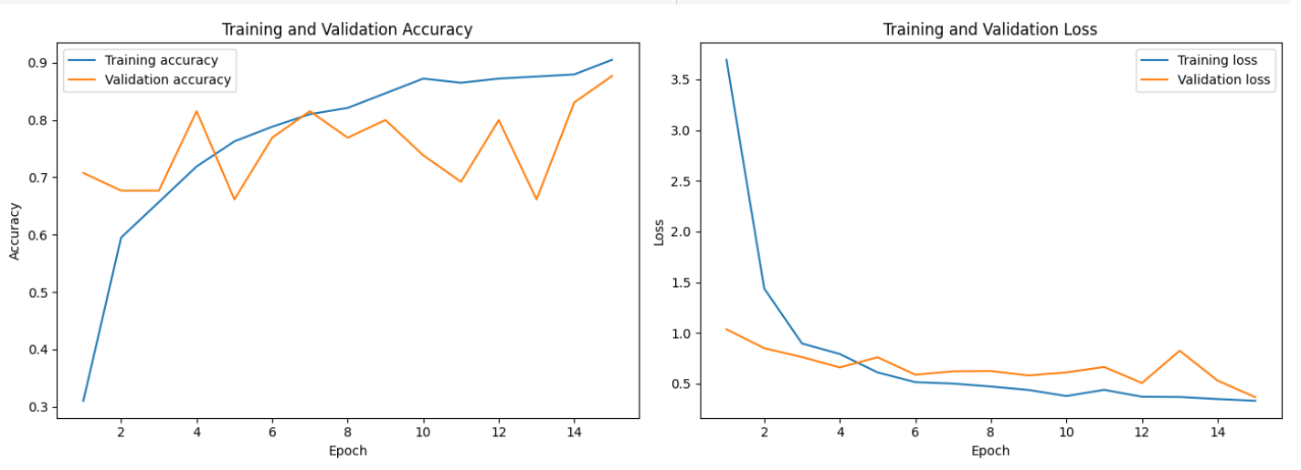
EXPERIMENTAL RESULTS
Comparative Analysis of CNN and VGG16 model
Accuracy and loss graph for finalised VGG16 model
Notes:
for the comparative analysis of CNN and VGG16 model,
Accuracies of the models were noted to be -> 83.33 for CNN and 87.69 for VGG16 model
the below graphs represents the accuracy and loss of our VGG16 during training and Validation

Slide 20
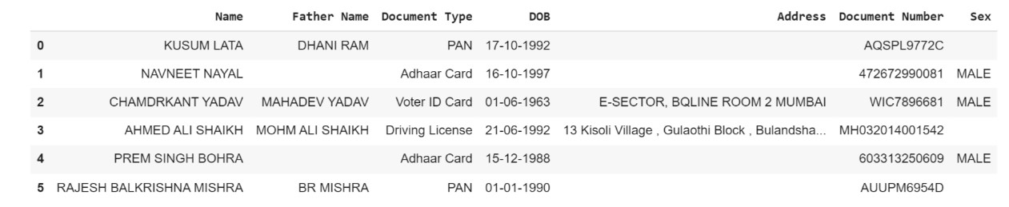
Information Extraction Model (OCR)
Applied OCR for text extraction from scanned documents.
Conducted image processing, text extraction, and cleaning.
Extracted information using keywords from the cleaned text.
Saved extracted data into a downloadable Excel file.
Text extraction using Tesseract OCR engine.
link
Notes:
For the Information Extraction Model (OCR) We have applied OCR to extract text from scanned documents. Extracted key information from the text and Saved the data in a downloadable Excel file.

Slide 21
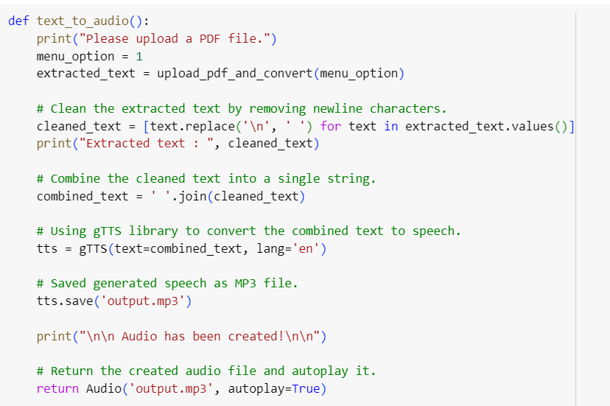
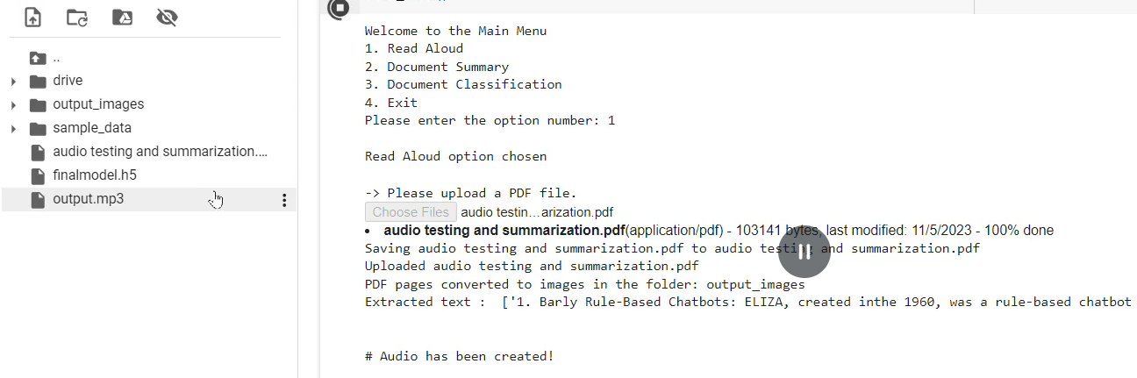
IV) READ ALOUD
Converts uploaded text into speech using the gTTS library.
Code
Snippet
Output
Notes:
Next up we have the 'Read Aloud' feature, which doesn't merely present the text; but brings the words to life through text-to-speech conversion, producing clear and crisp audio for the user.
the gTTS (Google Text-to-Speech) library is used to convert the combined text into speech. A gTTS object is created with the combined text and the language set to English. The generated speech is saved as an MP3 file named 'output.mp3'.

Slide 22
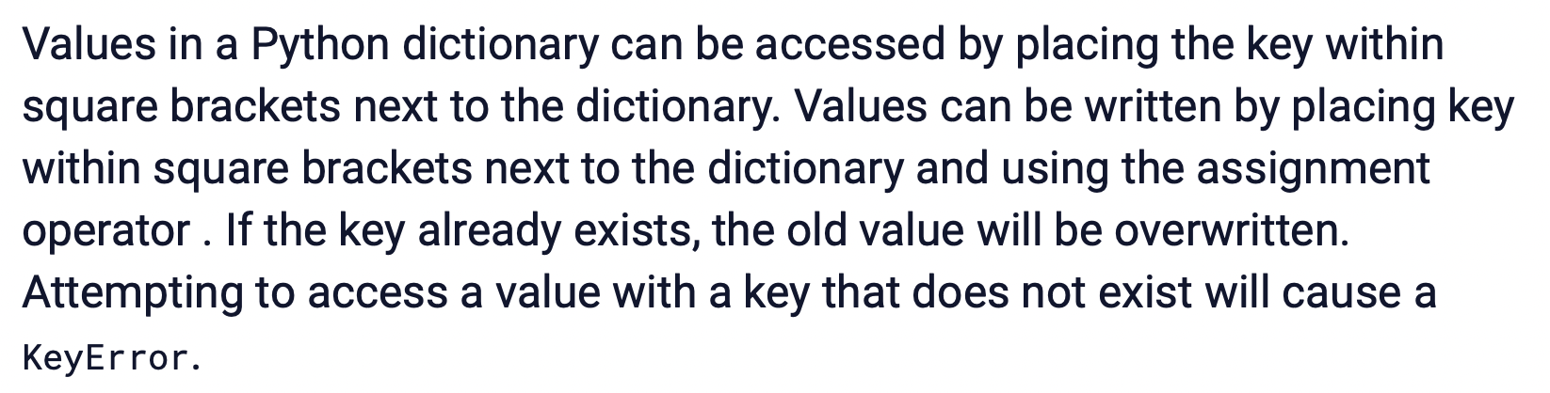
V) PARAPHRASING
The work leverages the BART model from the transformers library to paraphrase text extracted from a PDF. It begins by importing necessary components and utilizing a function that splits a given text into smaller, manageable chunks.
This is followed by the loading a pre-trained BART model and tokenizer, chunks the input text, and then paraphrases each chunk individually. The chunks are then recombined into a single paraphrased text.
Actual text
Paraphrased text BLEU Score: 0.6408
Notes:
text paraphrasing, which leverages the powerful BART model from the transformers library.
BART was chosen because it combines the strengths of bidirectional and autoregressive transformers, enabling it to both understand and generate text effectively. This model has been pre-trained on a vast corpus, making it adept at producing coherent and contextually relevant paraphrases.
Our approach involves splitting large input texts into manageable chunks, as BART has a token limit. Each chunk is then processed to generate high-quality paraphrased text. This ensures that the output retains the original meaning while being rephrased in a natural and fluent manner.

Slide 23
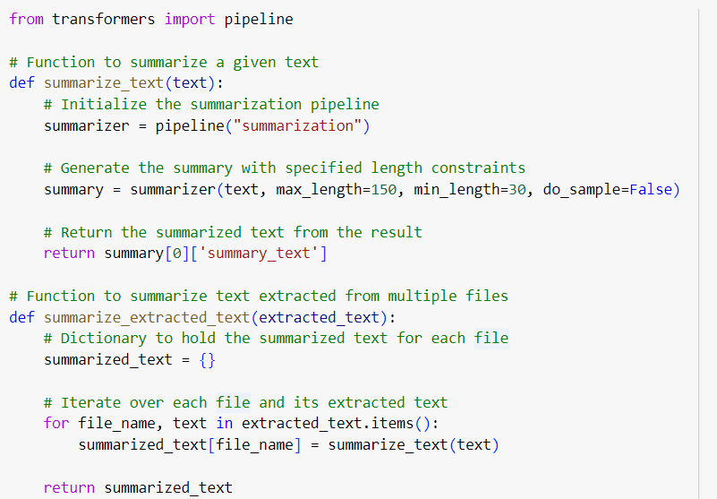
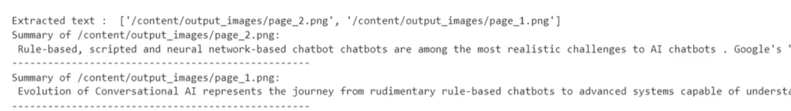
VI) SUMMARISATION
Document summarization condenses text into concise summaries, facilitating quick understanding and information extraction.
Code
Snippet
Output
Notes:
Next we have Document summarisation. We have utilized the Hugging Face Transformers library to perform text summarisation. This library simplifies the implementation of complex NLP models by offering user-friendly pipelines for various tasks.
We start by initializing the pipeline using pipeline("summarization"). The function returns the summarized text with specified constraints. The second function iterates over each file and its extracted text, summarizing each one using summarize_text() and storing the results in a dictionary.

Slide 24
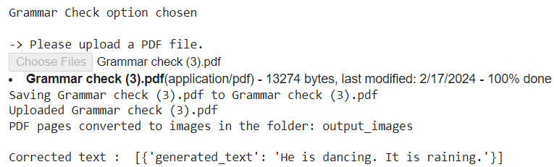
VII) GRAMMAR CHECK
The Grammar Check feature leverages Natural Language Processing (NLP) techniques to ensure accurate and context-aware text corrections. It begins with extracting text from PDF documents using the upload_pdf_and_convert function.
Next, a transformer-based model from Hugging Face's Transformers library, specifically the pszemraj/flan-t5-large-grammar-synthesis model, is used for grammar correction. The model, initialized via the pipeline function, processes the input text and generates a grammatically corrected version, which is retrieved through results[0]['generated_text'].
Original: I is dancing. It are raining.
Notes:
Next we have Grammar Check. The core of our Grammar Check feature is a transformer-based model from Hugging Face's Transformers library. The model is initialized via the pipeline function. It processes the input text and generates a grammatically corrected version.
For example if we provide Original Text: I is dancing. It are raining. The function returns Corrected Text as He is dancing. It is raining. highlighting the model's ability to understand context and correct grammatical errors effectively.

Slide 25
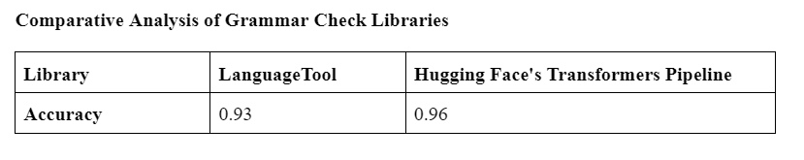
EXPERIMENTAL RESULTS
Notes:
Comparative Analysis of Grammar Check Libraries:
We have compared 2 Libraries:
LanguageTool: Achieved an accuracy of 93%
Hugging Face's Transformers Pipeline: Achieved an accuracy of 96%, Our chosen solution for grammar checking.

Slide 26
CONCLUSION AND FUTURE WORK
Different CNN designs have been evaluated and each displayed unique performance traits. Our custom CNN, with only minimal data enhancement, struck a compromise between efficiency and intricacy. Additional layers improved the ability to generalize performance of VGG16.
Furthermore, our interactive Q&A system yielded reliable outcomes with high confidence levels.
To ascertain document genuineness with most possible accuracy, we have fused up-to-date image processing techniques with the established techniques of comparing template shapes. Our project to develop AI-powered document intelligence has made certain that its templates are matched, answering interactive questions and document classification.
Subsequent development stages of AI-driven document intelligence will major on enhancing the accuracy levels of our models by training them on wider data sets as well as applying more advanced classifiers.
Notes:
In our journey of developing AI-driven document intelligence, we have achieved significant milestones:
Our custom CNN balances efficiency and complexity, Adding layers, as in VGG16, has improved generalization for diverse tasks. Our interactive Q&A system is highly reliable, providing accurate, confident responses and enhancing user experience. Combining advanced image processing with traditional template shape comparison, we ensure high document authenticity accuracy.
As we look ahead, our focus will be on further enhancing the accuracy and capabilities of our models as in Expanding Data Sets, Using Advanced Classifiers and Implementing Sophisticated Algorithms, Continuous Model Refinement and Incorporating Latest AI Advancements

Slide 27
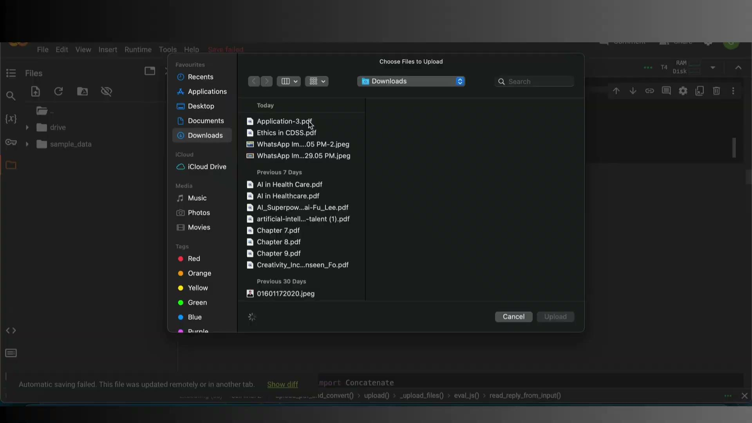
DEMO VIDEO

Slide 28
REFERENCES
[1] Sammed S. Admuthe , Hemlata P. Channe, 2021, Document Image Classification using Visual and Textual Features, INTERNATIONAL JOURNAL OF ENGINEERING RESEARCH & TECHNOLOGY (IJERT) Volume 10, Issue 09 (September 2021),
[2] P. Dhakal, M. Munikar and B. Dahal, "One-Shot Template Matching for Automatic Document Data Capture," 2019 Artificial Intelligence for Transforming Business and Society (AITB), Kathmandu, Nepal, 2019, pp. 1-6, doi: 10.1109/AITB48515.2019.8947440.
[3] Yenigalla, Harshitha, Bommareddy Revanth Srinivasa Reddy, Batta Venkata Rahul, and Nannapuraju Hemanth Raju. "Similar Document Template Matching Algorithm." arXiv preprint arXiv:2311.12663 (2023).
[4] Li, Xiaoxi, Yujia Zhou, and Zhicheng Dou. "UniGen: A Unified Generative Framework for Retrieval and Question Answering with Large Language Models." In Proceedings of the AAAI Conference on Artificial Intelligence, vol. 38, no. 8, pp. 8688-8696. 2024.
[5] Zhuang, Yuchen, Yue Yu, Kuan Wang, Haotian Sun, and Chao Zhang. "Toolqa: A dataset for llm question answering with external tools." Advances in Neural Information Processing Systems 36 (2024).

Slide 29
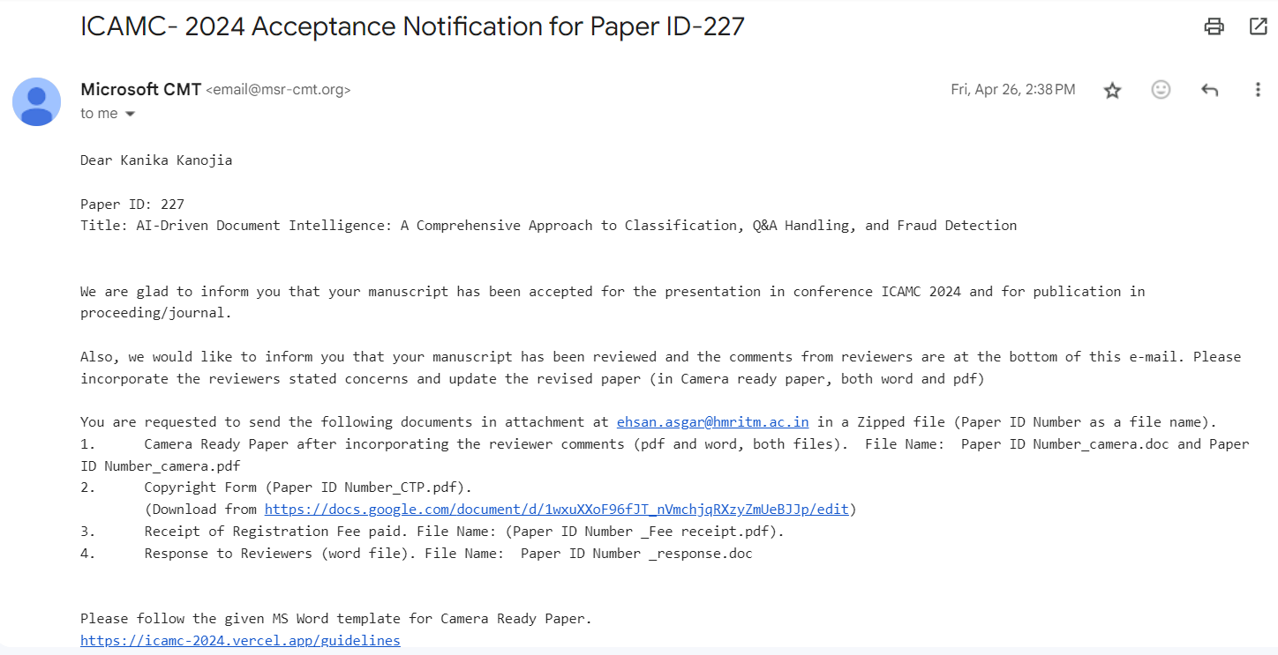
ACCEPTANCE LETTER
Notes:
this is acceptrance letter for our research paper submitted in conference.

Slide 30
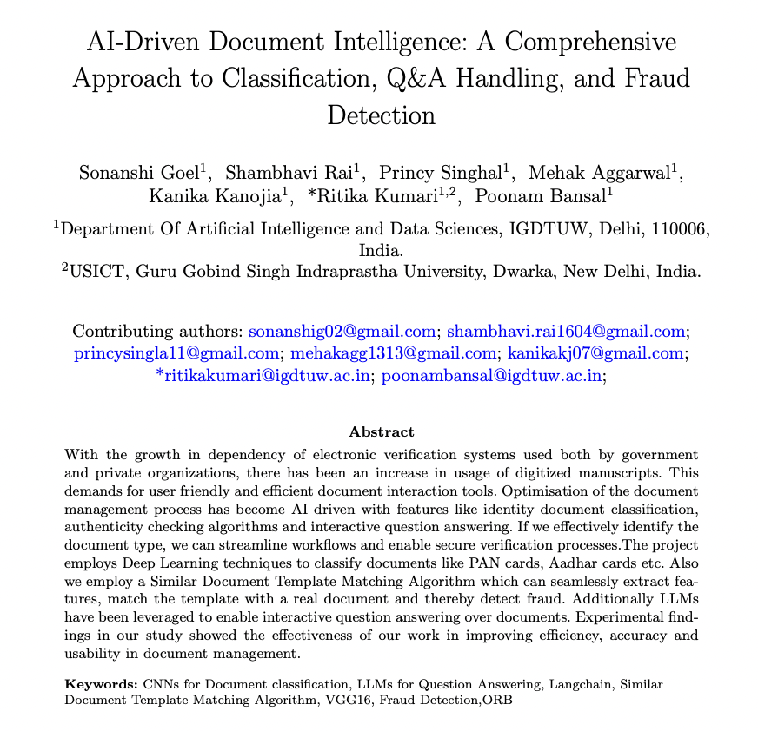
RESEARCH PAPER (link)

Slide 31
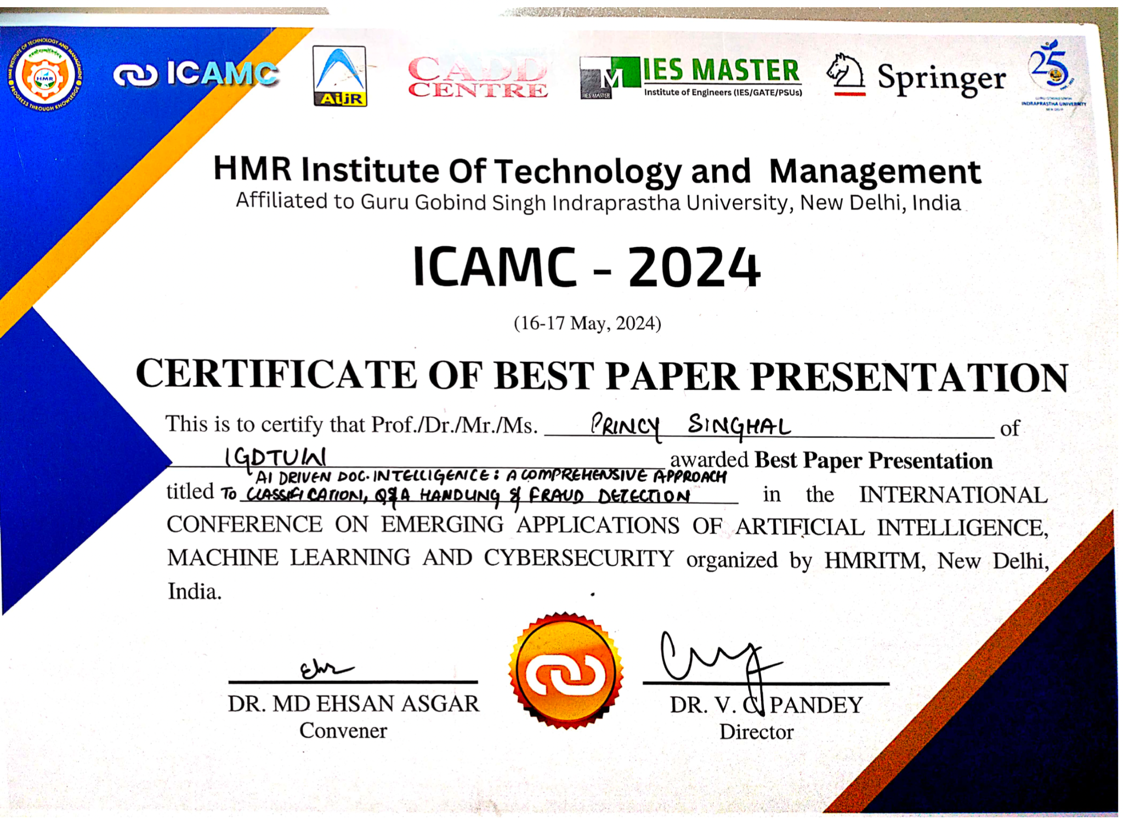
AWARD FOR BEST PAPER PRESENTATION
Notes:
this is the certificate pf best paper presentation which we presented in icamc conference in hmr college and received a cash prize of 1000 rs.

Slide 32
THANK YOU

